Slide 1
Yr 10 Week 7
Algebra
Gradient Intercept Form
K. Farmer

Slide 2
Hook
Watch the following “Maths Dude”short video.
https://www.youtube.com/watch?v=0-GHNJegZpQ

Slide 3
Lesson objective
By the end of this lesson you will be able to;
Identify the gradient and y intercept from a linear function.
Sketch a linear graph from a linear expression in the gradient intercept form.
Notes:
Lesson

Slide 4
Success Criteria
You will know you are successful in achieving the objective by…

Slide 5
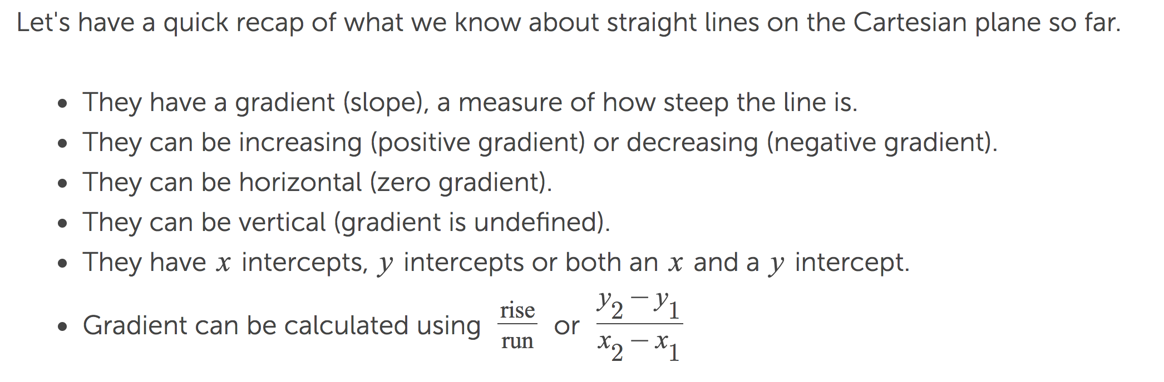
24
7
30
Date
Linear Algebra
EQ – How do I represent a line in the Gradient Intercept form
5
Notes:
Lesson objective (EQ)

Slide 6
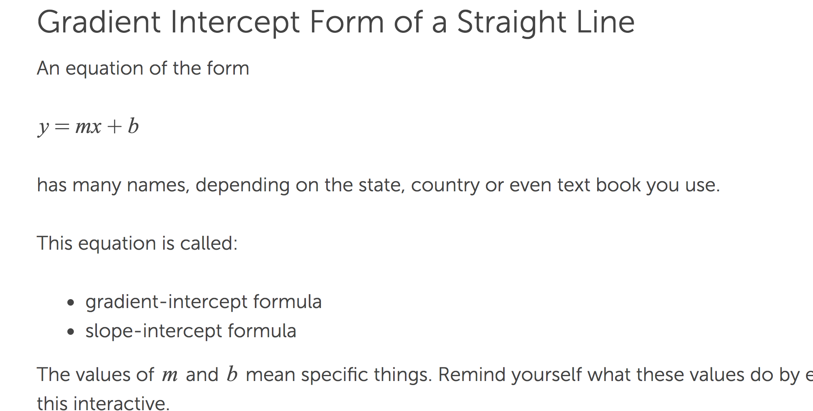
24
7
30
Date
Linear Algebra
EQ – How do I represent a line in the Gradient Intercept form
5
Notes:
Lesson objective (EQ)

Slide 7
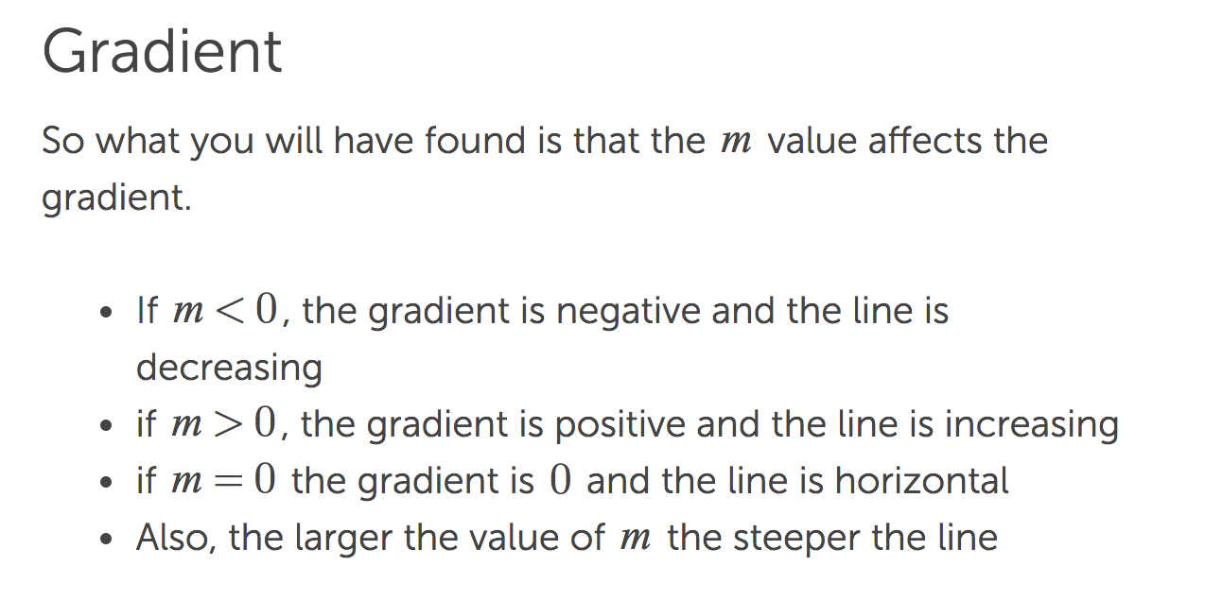
24
7
30
Date
Linear Algebra
EQ – How do I represent a line in the Gradient Intercept form
5
Notes:
Lesson objective (EQ)

Slide 8
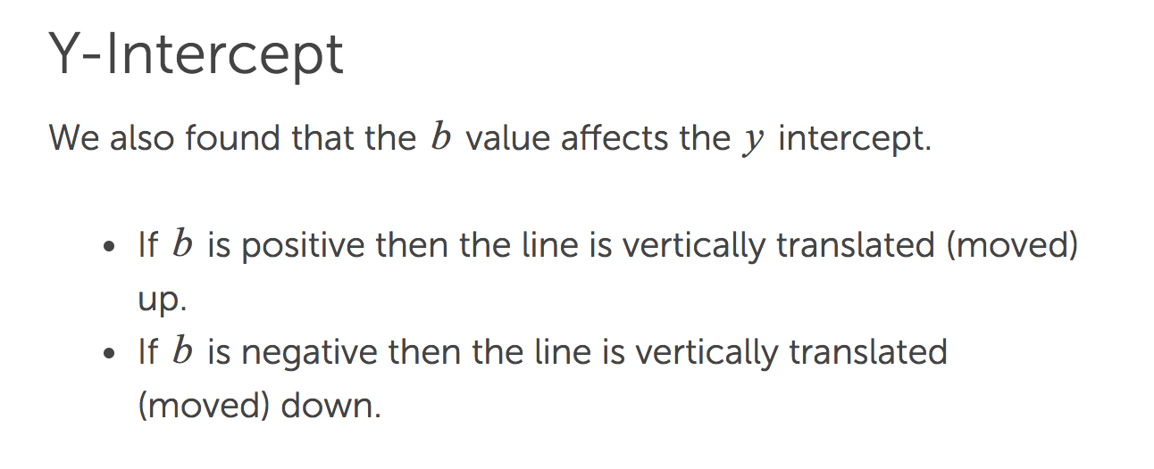
24
7
30
Date
Linear Algebra
EQ – How do I represent a line in the Gradient Intercept form
5
Notes:
Lesson objective (EQ)

Slide 9
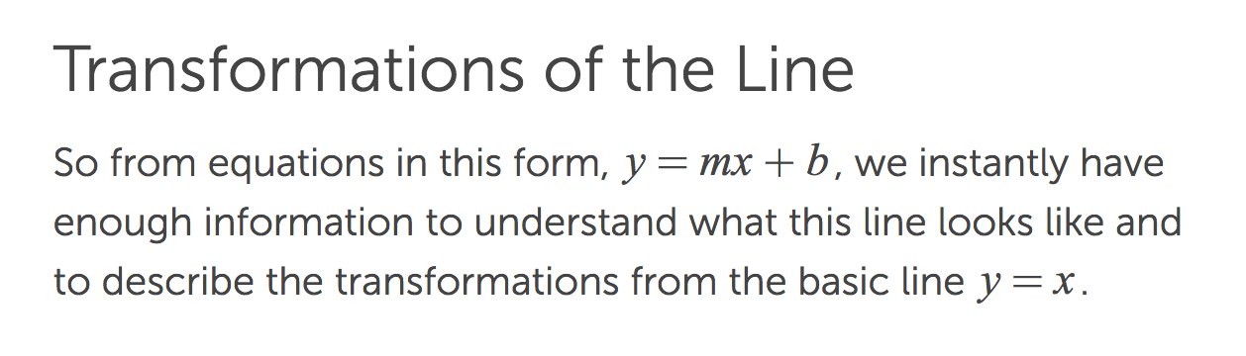
24
7
30
Date
Linear Algebra
EQ – How do I represent a line in the Gradient Intercept form
5
Notes:
Lesson objective (EQ)

Slide 10
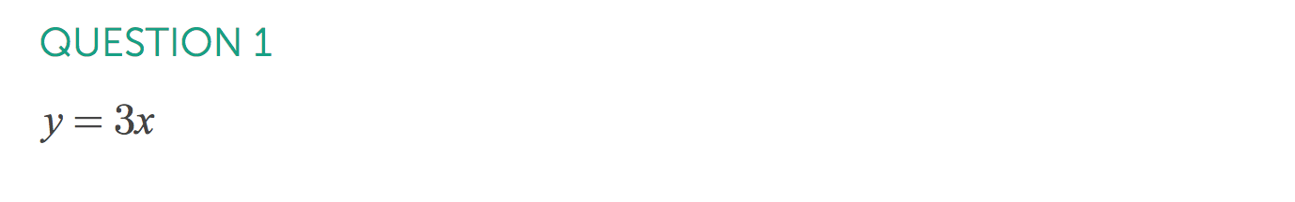
24
7
30
Date
Linear Algebra
EQ – How do I represent a line in the Gradient Intercept form
5
Notes:
Lesson objective (EQ)

Slide 11
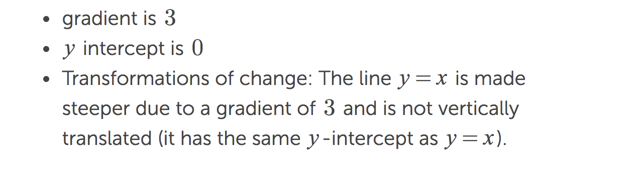
24
7
30
Date
Linear Algebra
EQ – How do I represent a line in the Gradient Intercept form
5
Notes:
Lesson objective (EQ)

Slide 12
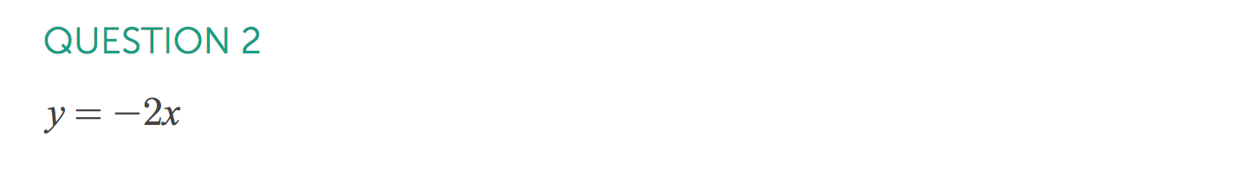
24
7
30
Date
Linear Algebra
EQ – How do I represent a line in the Gradient Intercept form
5
Notes:
Lesson objective (EQ)

Slide 13
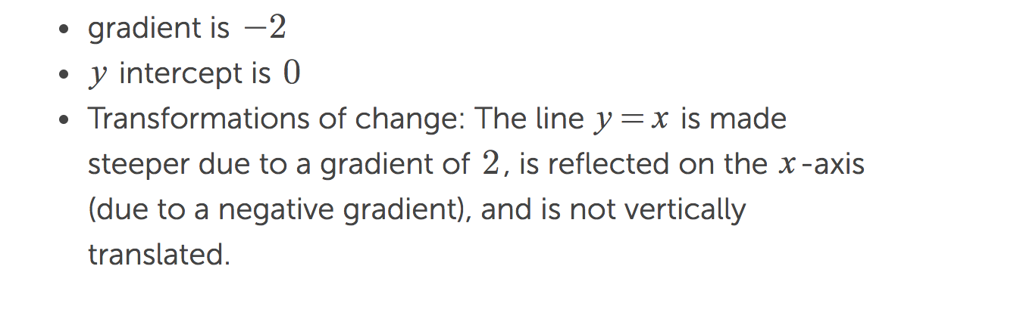
24
7
30
Date
Linear Algebra
EQ – How do I represent a line in the Gradient Intercept form
5
Notes:
Lesson objective (EQ)

Slide 14
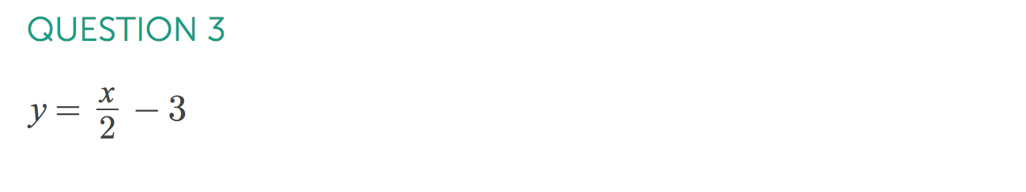
24
7
30
Date
Linear Algebra
EQ – How do I represent a line in the Gradient Intercept form
5
Notes:
Lesson objective (EQ)

Slide 15
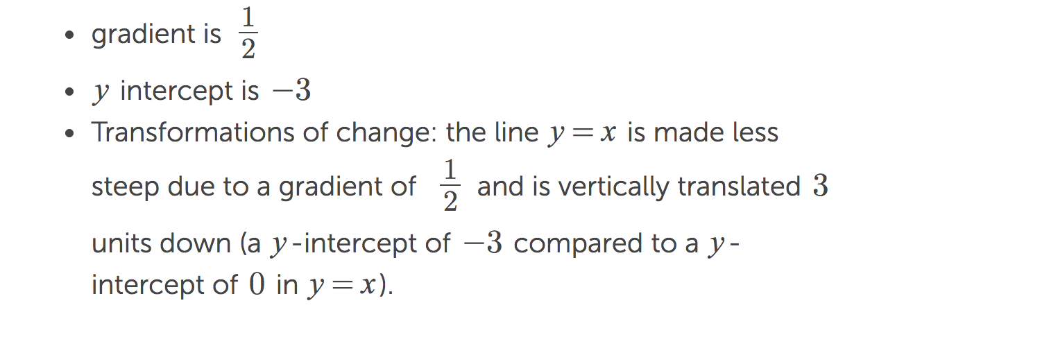
24
7
30
Date
Linear Algebra
EQ – How do I represent a line in the Gradient Intercept form
5
Notes:
Lesson objective (EQ)

Slide 16
Guided Activity
Gradient intercept form foldable.
Make sure this booklet is printed front to back to ensure it folds correctly.
Work through booklet. Solutions can be projected on the IWB.
Glue this in the LHS of INB
Notes:
Independent practice

Slide 17
Check for understanding
Success On target observation
Notes:
Check for understanding

Slide 18
Closure activity
Quick write
Notes:
Closure

